Slide 1
Greedy Algorithm

Slide 2
What is Greedy Algorithm?
A greedy algorithm always makes the choice that seems to be the best at that moment.
This means that it makes a locally-optimal choice in the hope that this choice will lead to a globally-optimal solution.

Slide 3
Advantages:
Always taking the best available choice is usually easy.
It usually requires sorting the choices.
Repeatedly taking the next available best choice is usually linear work.
But don't forget the cost of sorting the choices.
Much cheaper than exhaustive search.
Much cheaper than most other algorithms.

Slide 4
Example: Fractional Knapsack
Given weights and values of n items, we need to put these items in a knapsack of capacity W to get the maximum total value in the knapsack. Here, we can break items for maximizing the total value of knapsack.
Example :
Profit | 10 | 9 | 5 | 8 | 3 | 12 | 9 | 15
Weight | 3 | 5 | 1 | 2 | 1 | 9 | 6 | 4
Capacity : 15

Slide 5
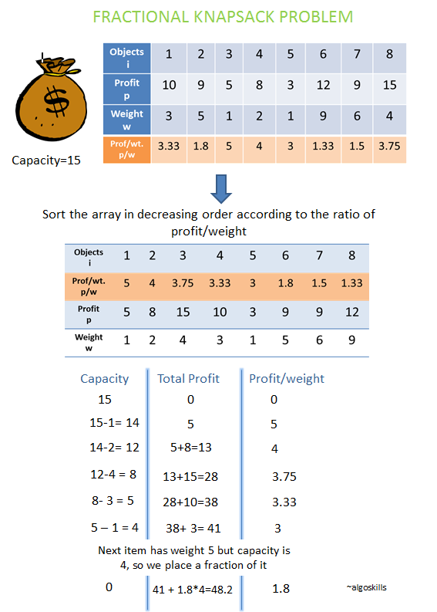
Example: Fractional Knapsack
The basic idea of the greedy approach is to calculate the ratio profit/weight for each item and sort the item on basis of this ratio.
Then take the item with the highest ratio and add them until we can’t add the next item as a whole and at the end add the next item as much as we can. Which will always be the optimal solution to this problem.

Slide 6
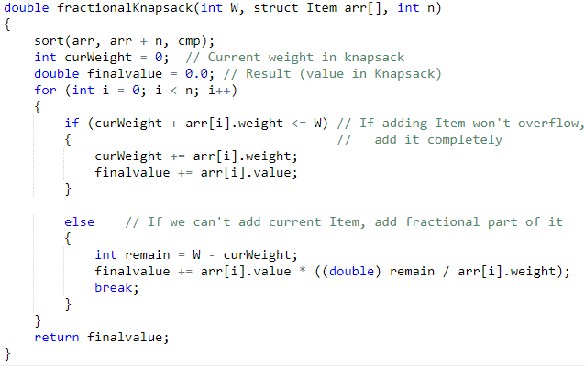
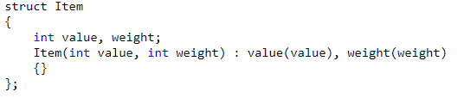
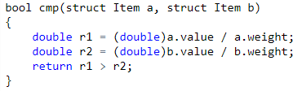
Implementation:

Slide 7
Activity Selection Problem
Problem Statement : You are given n activities with their start and finish times. Select the maximum number of activities that can be performed by a single person, assuming that a person can only work on a single activity at a time.
Input : arr[] = {{5,9},{1,2},{3,4},{0,6},{5,7},{8,9}}

Slide 8
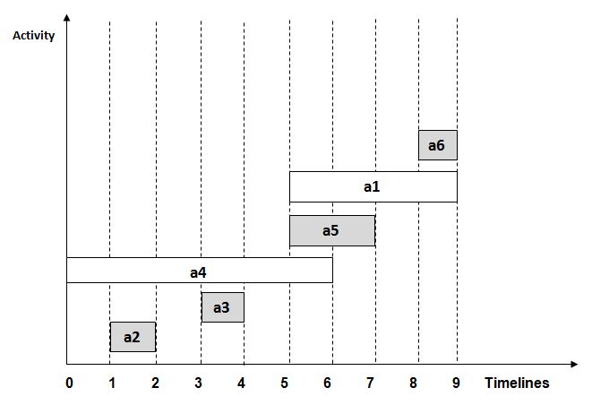
Step 1: Sort the given activities in ascending order according to their finishing time.
Step 2: Select the first activity from sorted array act[] and add it to sol[] array.
Step 3: Repeat steps 4 and 5 for the remaining activities in act[].
Step 4: If the start time of the currently selected activity is greater than or equal to the finish time of previously selected activity, then add it to the sol[] array.
Step 5: Select the next activity in act[] array.
Step 6: Print the sol[] array.
arr[] = {{5,9},{1,2},{3,4},{0,6},{5,7},{8,9}}

Slide 9
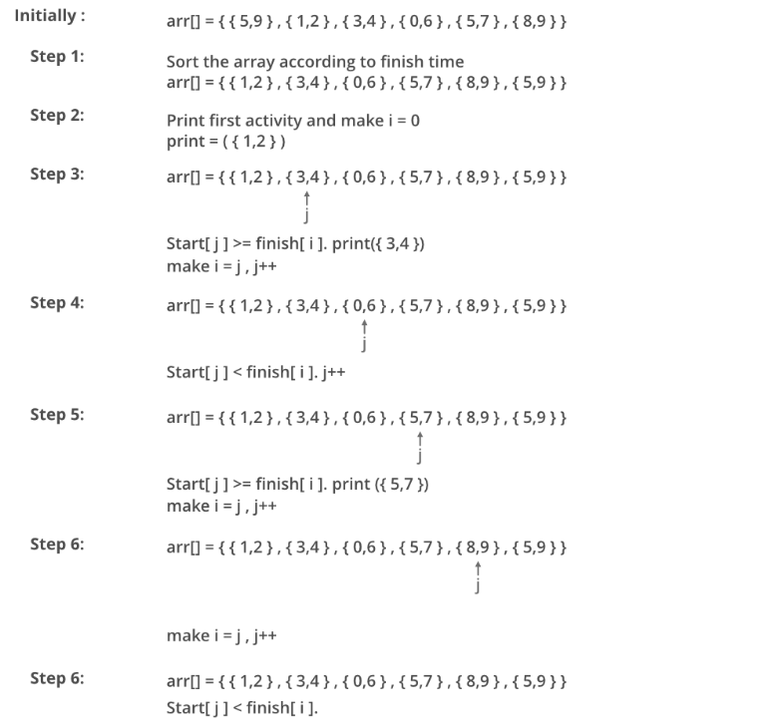

Slide 10
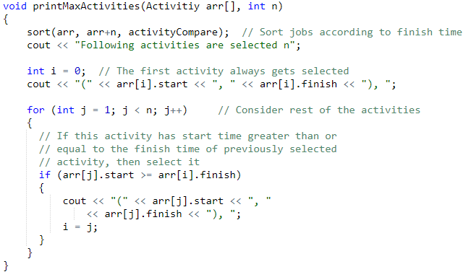
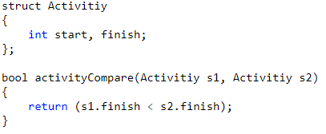
Implementation:

Slide 11
Special Case : Minimum Coin Change
Problem Statement: Given a value V, if we want to make change for V, and we have infinite supply of each of C = { C1, C2, .. , Cm} valued coins, what is the minimum number of coins to make the change?
Input: coins[] = {25, 10, 5}, V = 30
Output: Minimum 2 coins required
We can use one coin of 25 cents and one of 5 cents
Input: coins[] = {9, 6, 5, 1}, V = 11
Output: Minimum 2 coins required
We can use one coin of 6 cents and 1 coin of 5 cents

Slide 12
Disadvantages:
It is not suitable for problems where a solution is required for every subproblem like sorting.
In such problems, the greedy strategy can be wrong; in the worst case even lead to a non-optimal solution.

Slide 13
Exercise:
https://leetcode.com/problems/best-time-to-buy-and-sell-stock-ii/
https://leetcode.com/problems/task-scheduler/

Slide 14
Resources:
http://bluehawk.monmouth.edu/~rclayton/web-pages/f08-306/greed.html
https://www.guru99.com/greedy-algorithm.html

